Slide 1
CUSTOMER RELATIONSHIP MANAGAMENT SYSTEM
COAPPS.AI
COAPPS.AI
A comprehensive overview of our CRM system development journey
BY:
P. Vasanthi
D. Ganesh
N. Venkata Ravi Kumar
K. Nivas Reddy

Slide 2
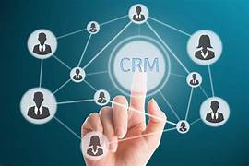
WHY CRM ?
A Customer Relationship Management (CRM) system is indispensable for businesses due to its multifaceted benefits.
CRM systems provide a centralized platform to manage customer interactions, enabling businesses to better understand their customers' needs and preferences. This leads to more personalized and effective communication, fostering stronger relationships with customers.
By tracking customer interactions and analyzing data, CRM systems help businesses identify sales opportunities, target marketing campaigns more effectively, and streamline the sales process. This can result in increased sales and revenue generation.

Slide 3
Existing CRM
CRM systems often store basic contact details such as names, addresses, phone numbers, and email addresses. However, relying solely on this data may lead to incomplete customer profiles and limited insights into customer behavior and preferences.
Time-consuming analysis, difficulties in identifying trends.
Risk of data breaches, unauthorized access, and compliance violations.
Proposed CRM
Our proposed CRM (Customer Relationship Management) system is designed to streamline and optimize the management of customer relationships for businesses of all sizes.
Our CRM system will facilitate better customer service and support by enabling users to track customer inquiries, issues, and requests. Users can assign tickets to team members, track ticket status, and ensure timely resolution of customer issues.
Our CRM system will enable businesses to store, organize, and manage customer contact information effectively. Users can easily add, edit, and delete contacts, as well as track interactions and communications with each contact.
Advantages:
User-Friendly Interface
Integration with External Systems

Slide 4

Feasibility Study
A feasibility study for a CRM (Customer Relationship Management) system evaluates the viability and potential success of implementing such a system within an organization.
Understanding the feasibility of a project helps in making informed decisions and allocating resources effectively.
Types of Feasibility Study
Technical Feasibility
Economic Feasibility
Social Feasibility
1. Technical Feasibility
Assessment of the organization's existing technical infrastructure and capabilities to support the implementation of a CRM system.
In technical feasibility , we check weather we have required technical resources (like hardware and software) to develop the project
This feasibility study also analyzes technical skills and capabilities of technical team, existing technology can be used or not, maintenance and up-gradation is easy or not for chosen technology etc.

Slide 5
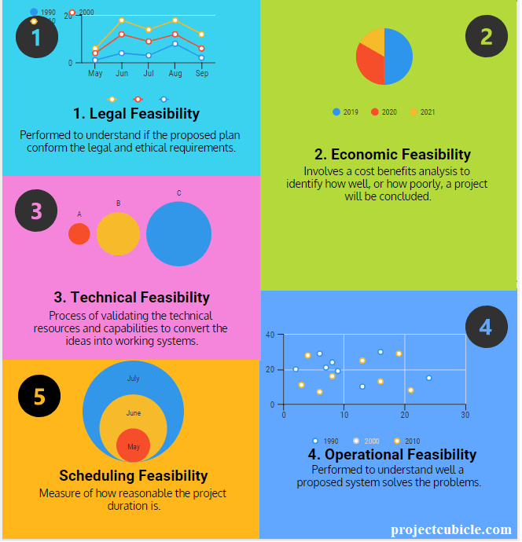
Economic Feasibility
In Economic Feasibility study, cost and benefit of the project is analyzed.
In this feasibility study, a detail analysis is carried out to know what will be cost of the project including hardware and software resources required, design and development cost and so on.
Consideration of alternative financing options, such as budget allocation, external funding, or financing arrangements with CRM vendors.
It is also analyzed weather project will be beneficial for organization or not.
Operational Feasibility
In operational feasibility study, we examine whether the project satisfies the requirements identified in the requirement analysis phase.
Legal Feasibility
This examines whether the software development and deployment comply with legal and regulatory requirements. Key considerations include:
Intellectual property rights.
Data protection and privacy laws.
Compliance with industry-specific regulations.

Slide 6
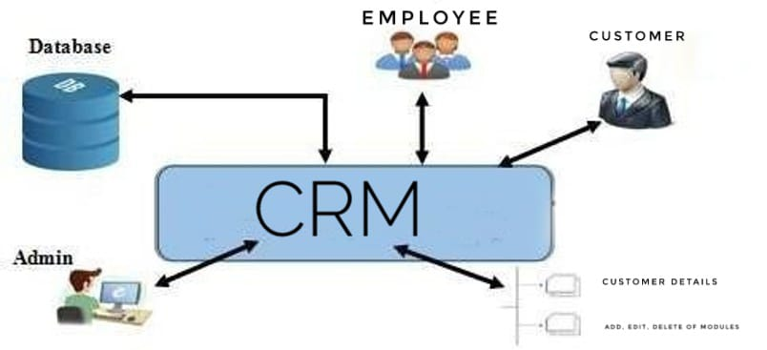
Overview of CRM
Here is the actual scenario happened in this Customer Relationship Management System

Slide 7
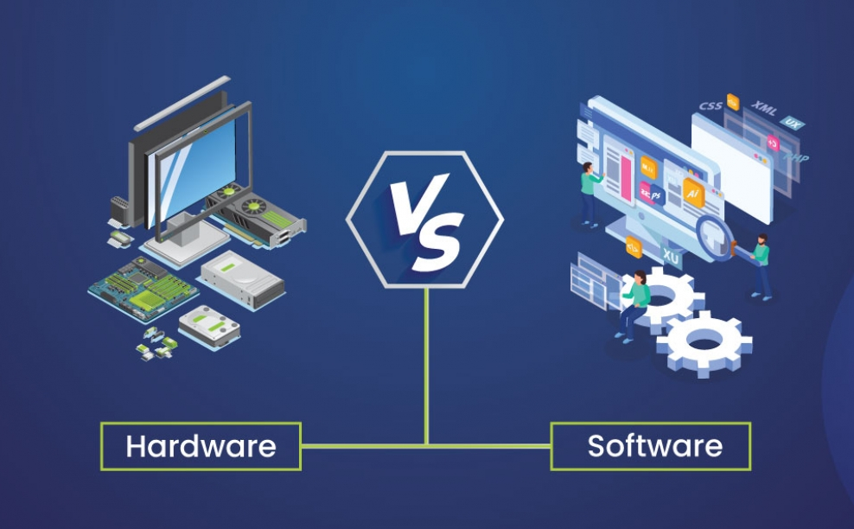
Hardware Requirements:
Processor – Multi-core processor (e.g., Intel Core i5 or higher)
RAM – Minimum 4GB
Storage – Solid State Drive (SSD)
Software Requirements:
Operating system - Windows8 or Above
Development Environment
React.js
MySQL
Node.js
HTML, JavaScript, CSS (fundamental languages used for building frontend)
Code Editor – Visual Studio Code

Slide 8
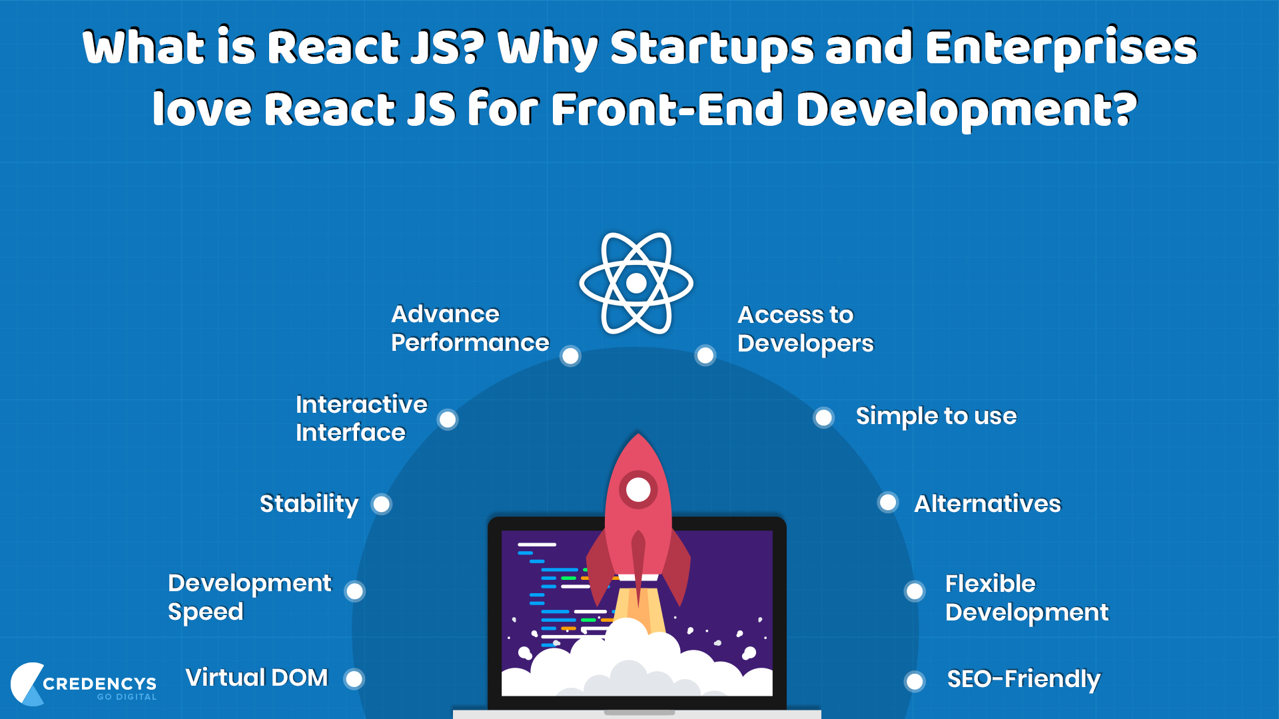
Frontend technologies
ReactJS : ReactJS is a JavaScript library primarily used for building user interfaces (UIs) and single page web applications. ReactJS allows developers to create reusable UI components and efficiently manage the state of their applications.
Features of react:
Component-Based Architecture
Virtual DOM
JSX (JavaScript XML)
Unidirectional Data Flow
React Router
React Hooks
fundamental languages used for building frontend:
HTML (Hypertext Markup Language)
JavaScript
CSS (Cascading Style Sheets)

Slide 9
Backend technologies
Node.js: Node.js is a powerful open-source, cross-platform JavaScript runtime environment that executes JavaScript code outside of a web browser. It is built on Chrome's V8 JavaScript engine and was initially developed by Ryan Dahl in 2009.
Features of Node.js:
JavaScript Runtime Environment
Asynchronous and Event-Driven
NPM (Node Package Manager):
Server-Side Web Development
Built-in HTTP Module

Slide 10
Express.js
Express.js is a minimalist web application framework for Node.js, designed to make building web applications and APIs easier and faster.
Express.js simplifies the process of handling HTTP requests and responses by providing a set of intuitive methods and middleware functions. These allow developers to define routes for different HTTP methods (such as GET, POST, PUT, DELETE) and handle incoming requests accordingly.
Express.js also supports middleware, which are functions that have access to the request and response objects.
RESTful API Development: Express.js is well-suited for building RESTful APIs (Application Programming Interfaces) due to its routing capabilities and middleware support. Developers can define routes for handling API endpoints and use middleware to implement features like authentication, authorization, input validation, and more.

Slide 11
MySQL
MySQL: MySQL is an open-source relational database management system (RDBMS) that is widely used for managing structured data.
Features of MySQL:
Relational Database Management System (RDBMS):
Open Source
Client-Server Architecture
SQL (Structured Query Language):
Data Types
Indexes and Keys
Scalability and Replication

Slide 12
CRM FLOWCHART

Slide 13
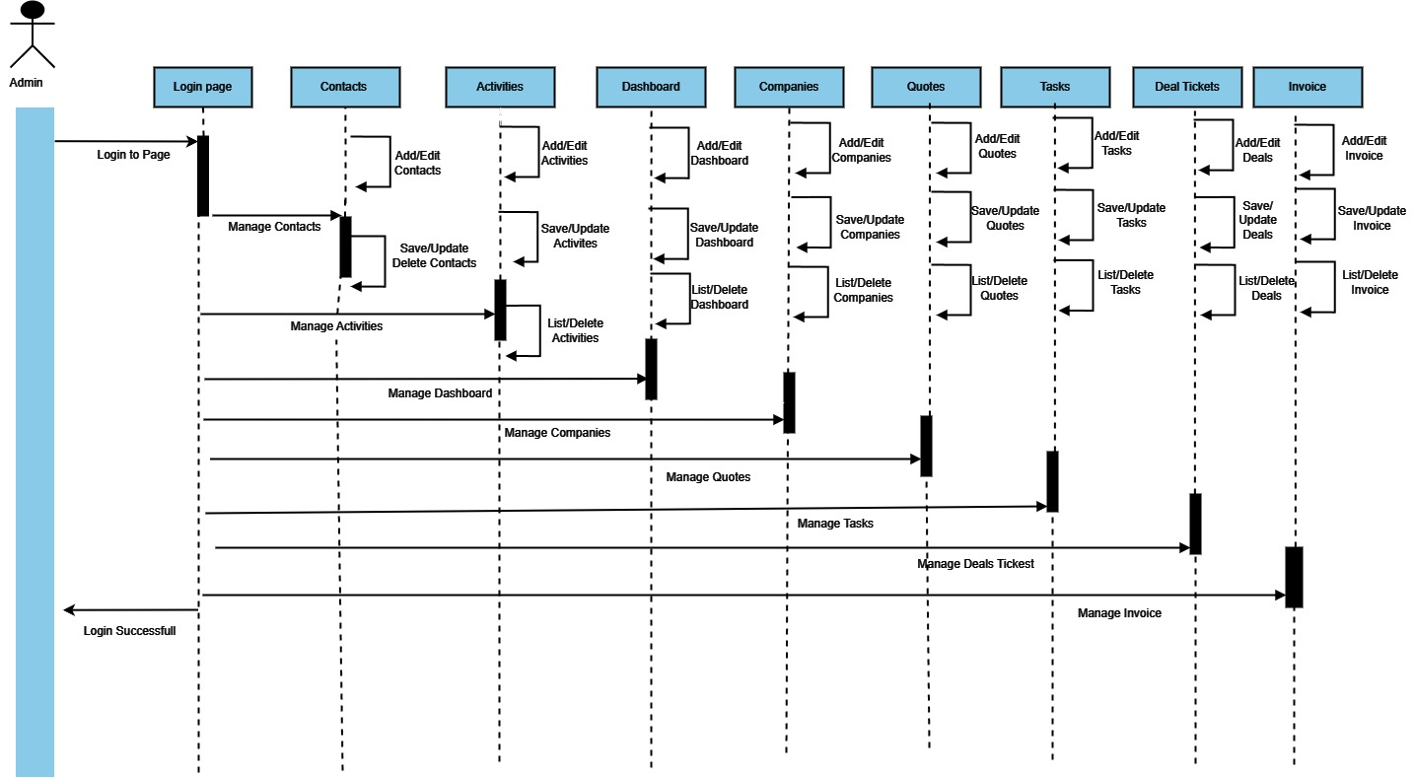
Sequence Diagram for Admin

Slide 14
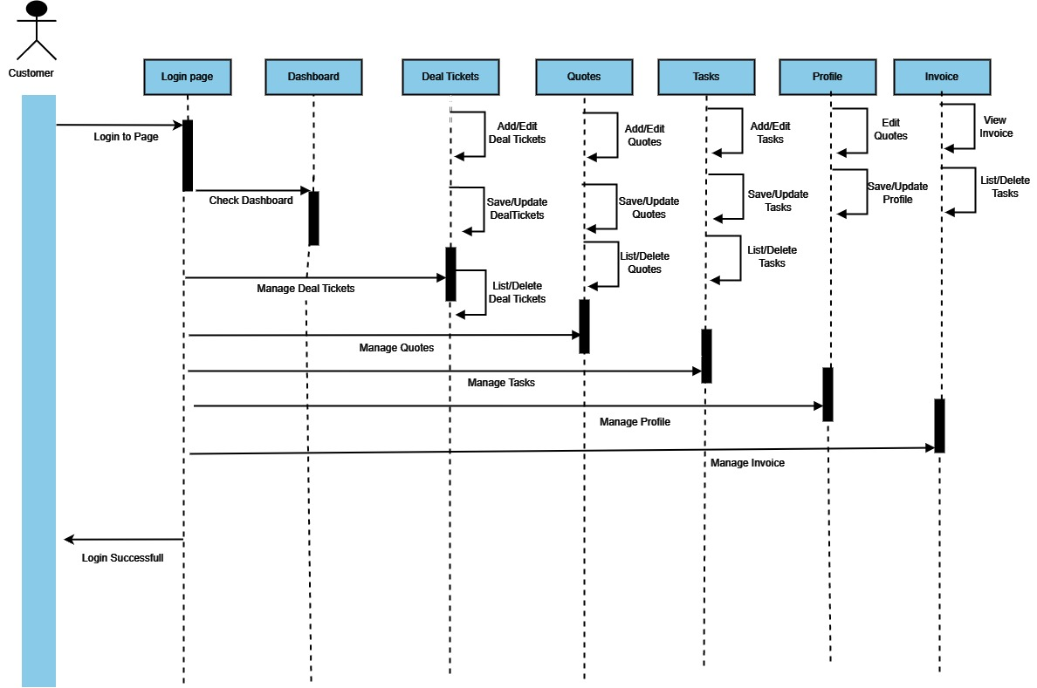
Sequence Diagram for Customer

Slide 15
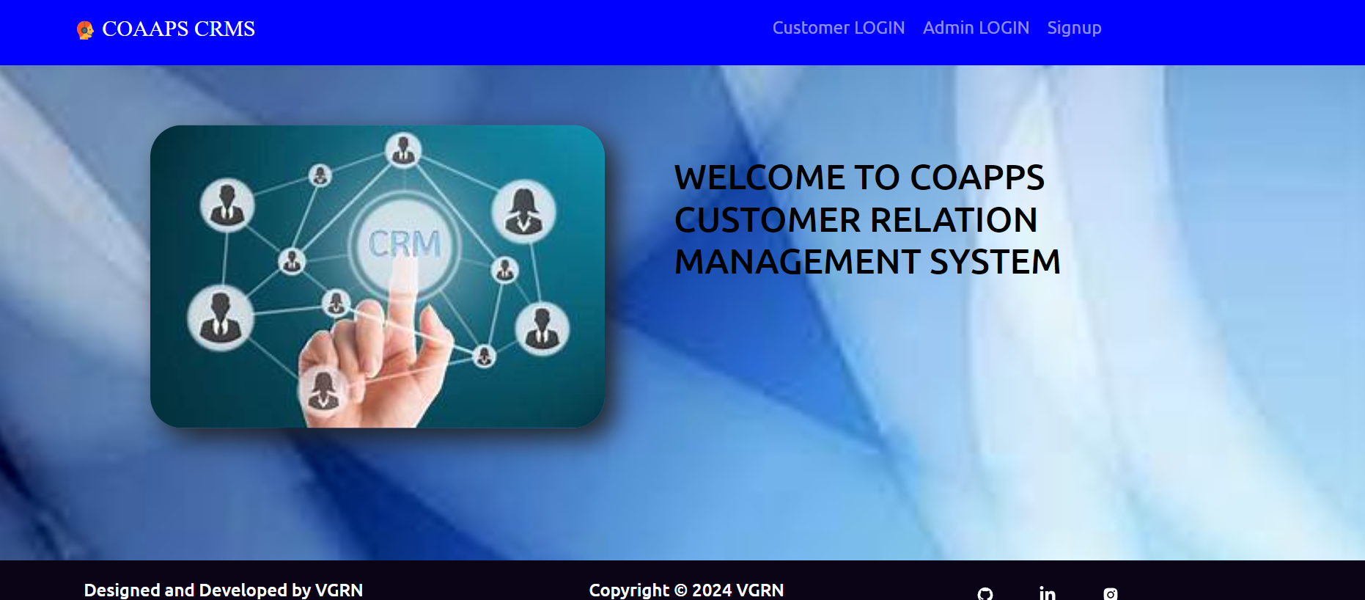
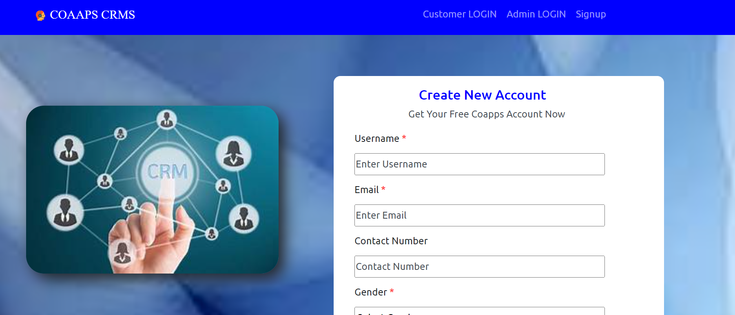
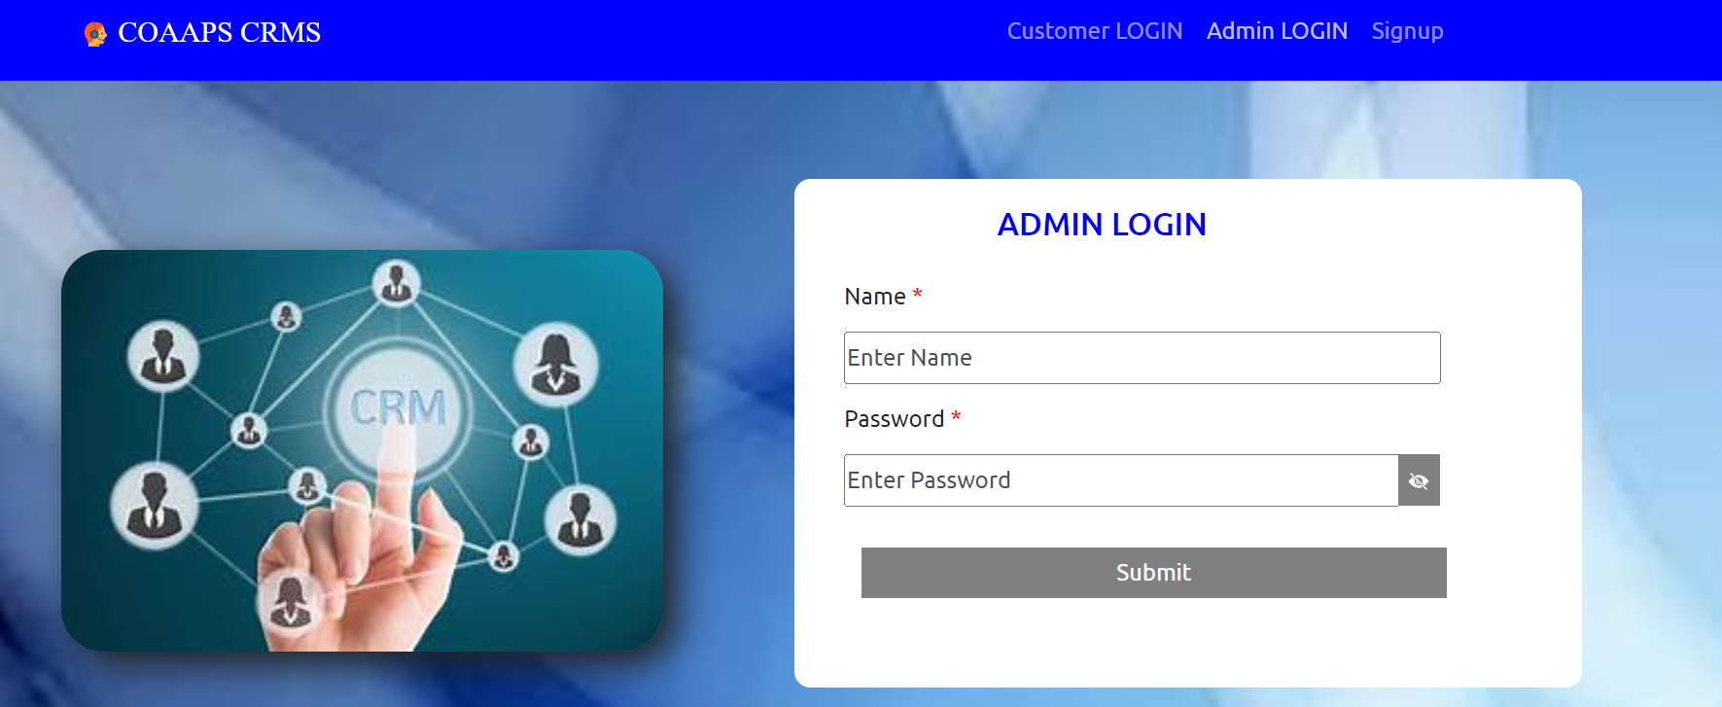
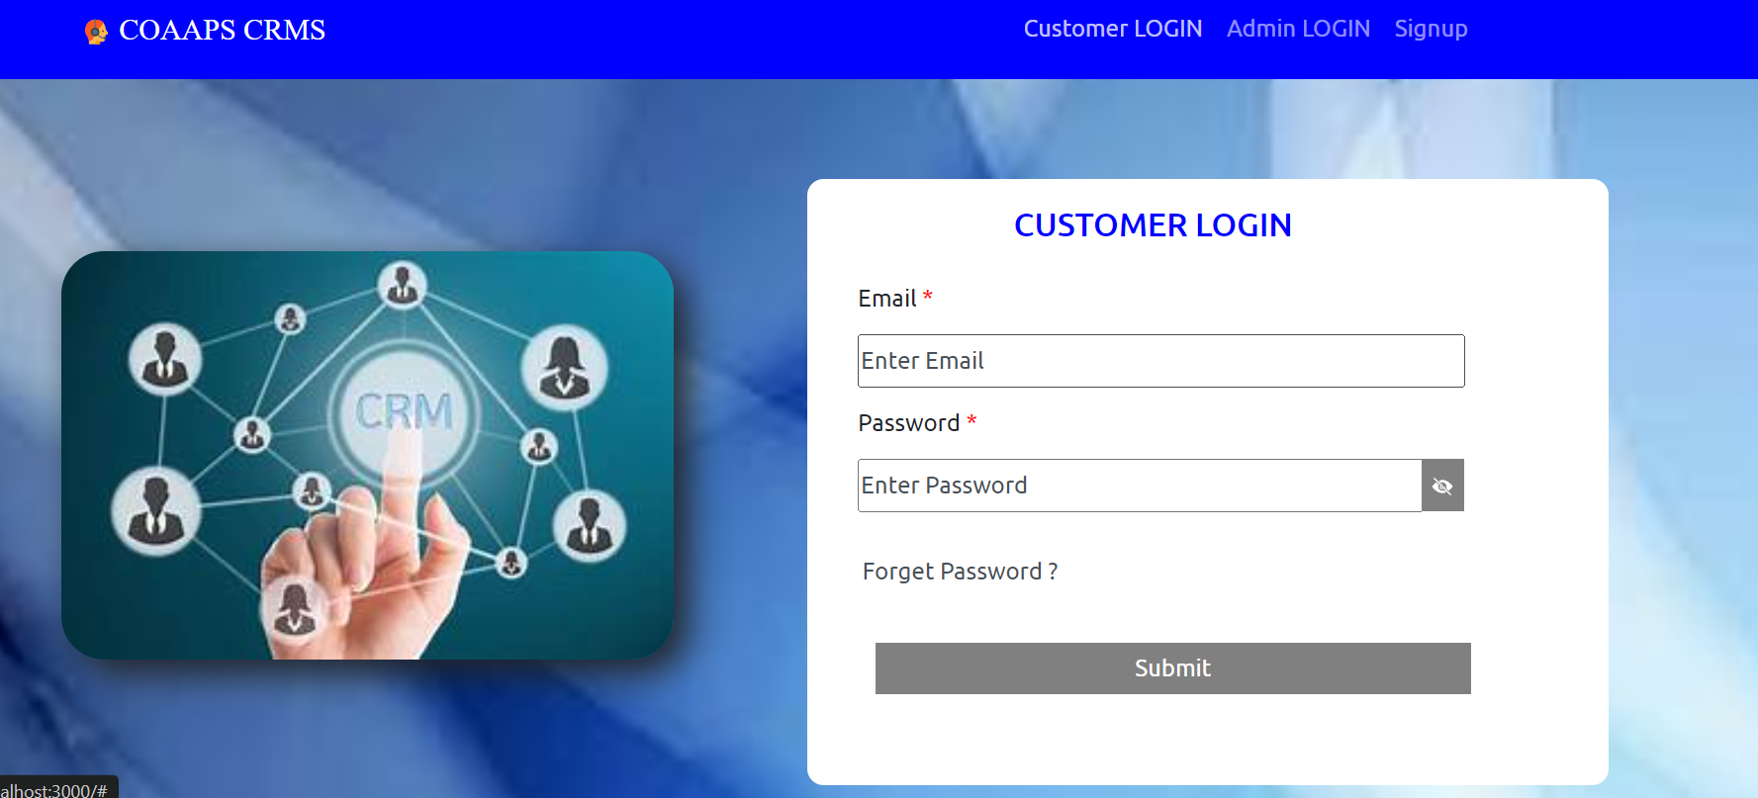
Output
Home Page
Signup page
Admin Login Page
Customer Login Page

Slide 16
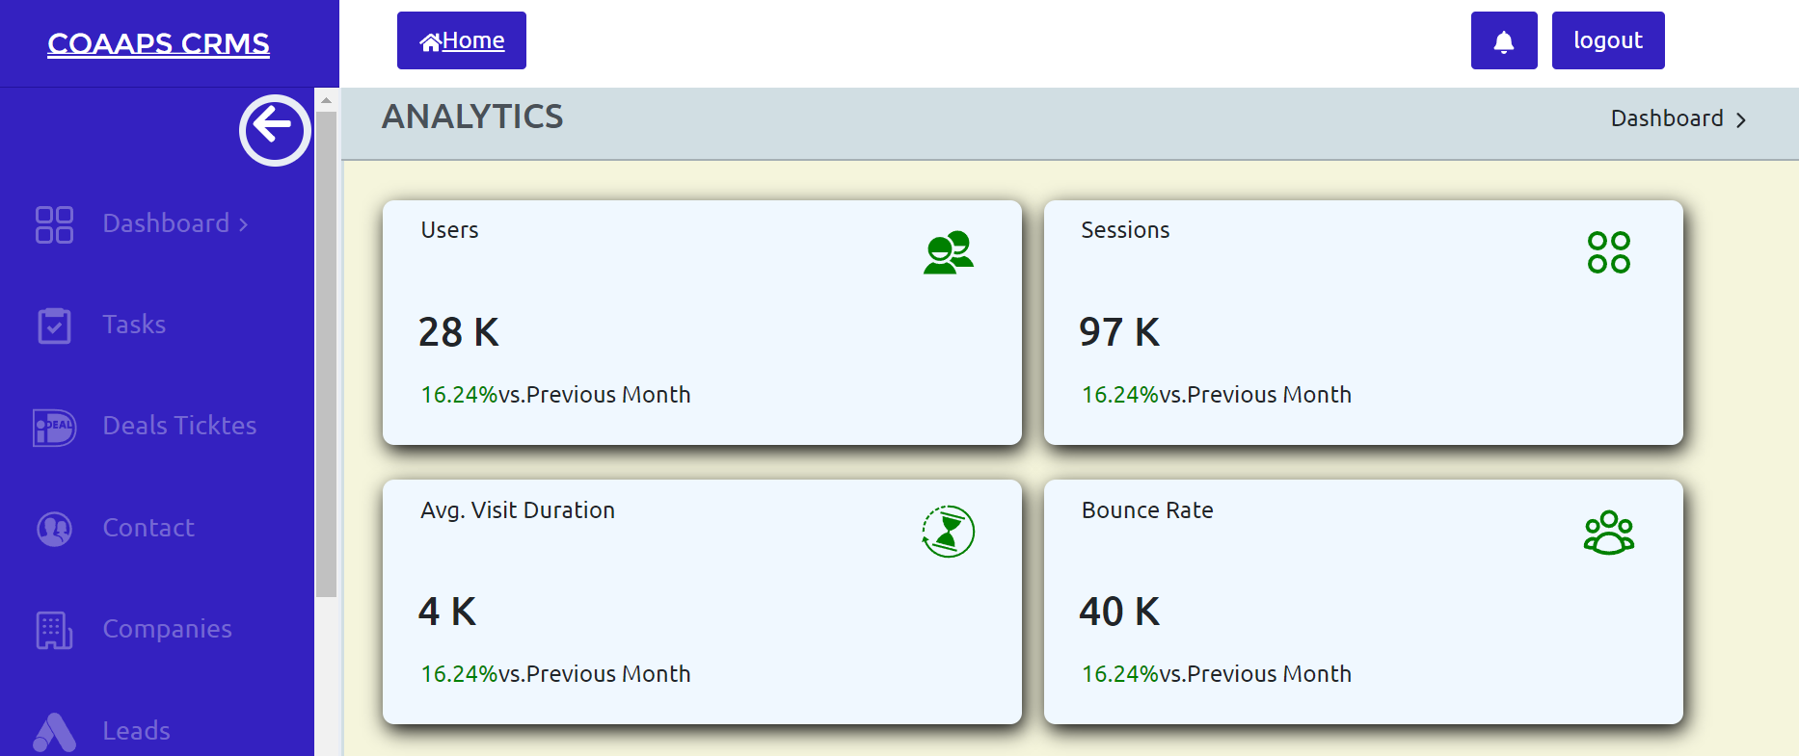
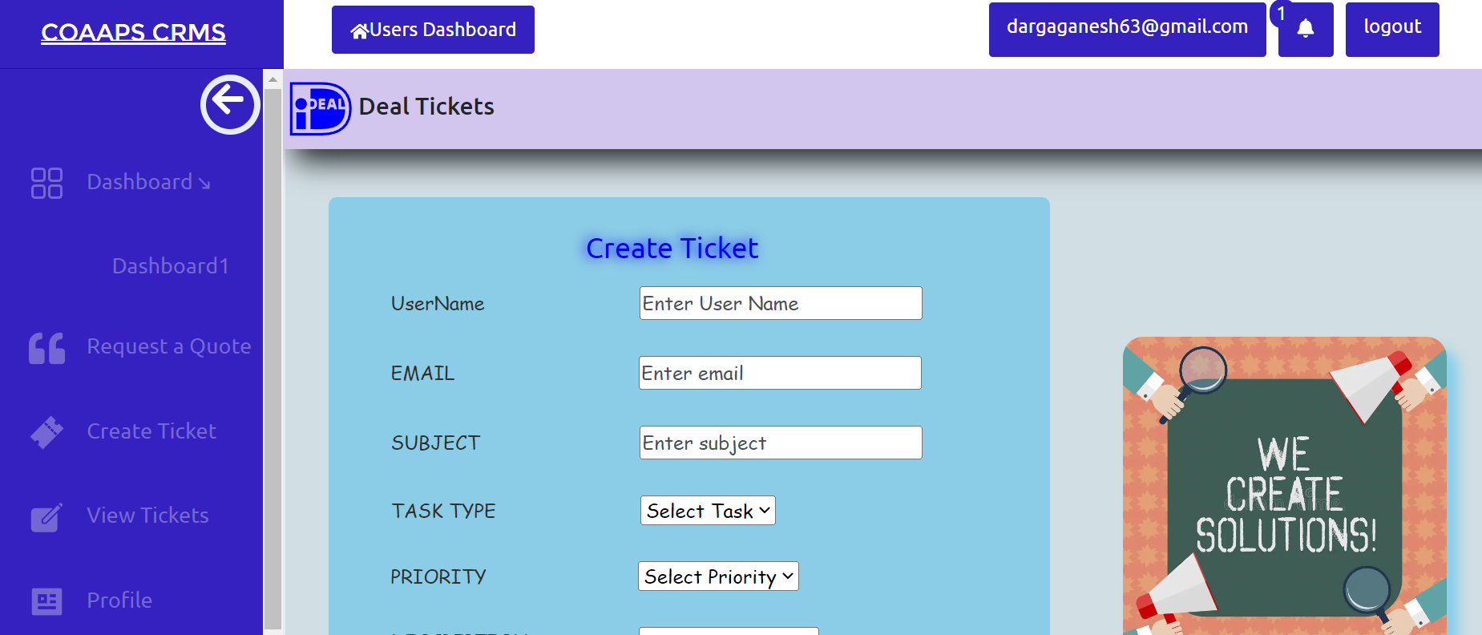
Admin Dashboard
Customer Ticket page

Slide 17
Conclusion
The objective of our project has been successfully realized through the development of a comprehensive Customer Relationship Management (CRM) system. Utilizing a combination of React.js, JavaScript, HTML, CSS, and Node.js, we have designed and implemented a robust solution tailored to meet the needs of modern businesses
Future Enhancement
Enhancing CRM systems with AI capabilities for predictive analytics, personalized recommendations, and automated customer interactions to improve sales forecasting, marketing campaigns, and customer service efficiency.
Implementing voice recognition and natural language processing (NLP) capabilities to enable voice-controlled CRM interactions, voice search, and voice-based customer support, catering to the growing trend of voice-first technology.
Integrating CRM with various communication channels such as social media, messaging apps, and IoT devices to provide seamless customer experiences across multiple touchpoints and channels.

Slide 18
QUERIES ?

Slide 19
THANK YOU

